Slide 1
Simultaneous
Inferences
Suppose we run a regression analysis and we want to create 95% confidence intervals for both β₀ and β₁.
If we were to create two separate confidence intervals, they would not provide 95% confidence that both β₀ and β₁ were in their respective intervals.
If the inferences were independent, then the probability that both β₀ and β₁ were in their respective intervals is (.95)², or only .9025.

Slide 2
Simultaneous
Inferences
Analysis of data frequently requires a series of estimates or tests, and we need assurances about the correctness of the entire set, called a family of estimates or tests.
For the previous example, the family consisted of two estimates, one for β₀ and one for β₁.
A statement confidence coefficient indicates the proportion of correct estimates that are obtained when repeated samples are selected and the specified confidence interval is calculated for each sample.
For example, a statement confidence coefficient .95 for β₀ indicates that if repeated samples are selected and confidence intervals for β₀ were calculated for each sample, 95% of the intervals would contain β₀.

Slide 3
Simultaneous
Inferences
A family confidence coefficient indicates the proportion of families of estimates that are entirely correct when repeated samples are selected and the specified confidence intervals for the entire family are calculated for each sample.
For example, for a family consisting of β₀ and β₁, a family confidence coefficient .95 indicates that if repeated samples are selected and confidence intervals for β₀ and β₁ are calculated for each sample, 95% of the samples would lead to intervals for β₀ and β₁ that both contain β₀ and β₁, respectively.
For 5% of the samples, either one or both the intervals would be incorrect (not contain the corresponding parameter).

Slide 4
Simultaneous
Inferences
To use a Bonferroni procedure for developing joint confidence intervals for β₀ and β₁, each statement confidence coefficient is adjusted to be higher than 1 – α, so that the family confidence coefficient is at least 1 – α.
The procedure is a general one that can be applied in many cases, not just for the joint estimation of β₀ and β₁.
Recall the ordinary confidence intervals for β₀ and β₁

Slide 5
Simultaneous
Inferences
What is the probability that at least one of the intervals is incorrect? Let A₁ denote the event that the first confidence interval does not contain β₀ and A₂ denote the event that the second confidence interval does not contain β₁.
We know P(A₁) = α and P(A₂) = α. We also have that
Letting A₁(bar) denote the compliment of A₁, that is that the first ci does contain β₀, and A₂(bar) denote the compliment of A₂, that is that the second ci does containβ₁, to obtain the probability that both intervals are correct, we have

Slide 6


Simultaneous
Inferences
Next we use the fact that
to obtain the Bonferroni inequality
which for our situation is

Slide 7
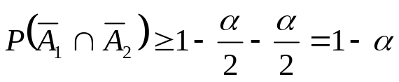
Simultaneous
Inferences
Thus, if β₀ and β₁ are separately estimated from the same sample with 95% confidence intervals, the Bonferroni inequality guarantees us a family confidence coefficient of at least 1-2(.05)=.90 that both intervals are correct.
We can use the Bonferroni inequality to obtain a family confidence coefficient of at least 1-α for estimating both β₀ and β₁.
We do this by estimating β₀ and β₁ separately with statement confidence coefficients of 1-(α /2) each.
This gives,

Slide 8
Simultaneous
Inferences
For example, if β₀ and β₁ are separately estimated from the same sample with 97.5% confidence intervals (α=.025), the Bonferroni inequality guarantees us a family confidence coefficient of at least 1-(2*.025)=.95 that both intervals are correct.
Thus the (1-α)100% family confidence intervals for β₀ and β₁ by the Bonferroni procedure are
Note that we used t(1-α/(2*2), n-2) above since originally we used t(1-α/2, n-2). We use α/2 in place of α and divide by 2, which gives (α/2)/2 = α/(2*2)= α/4.

Slide 9
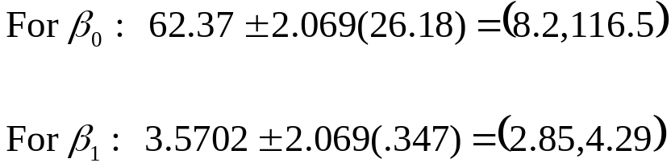
Simultaneous
Inferences
For the Toluca example, 90% (α=.1) family confidence intervals for β₀ and β₁ require t(1-.1/4,23) = t(.975,23) = 2.069.
We have that
Therefore, the joint confidence intervals are
Thus we conclude with 90% confidence that both β₀ is between 8.2 and 116.5 and β₁ is between 2.85 and 4.29.

Slide 10
Simultaneous
Inferences
This can be extended to multiple regression where we have more than 2 Betas. Suppose that we have g Betas in our model.
We can use the Bonferroni inequality to obtain a family confidence coefficient of at least 1-α for all g Betas.
We do this by estimating each Beta separately with statement confidence coefficients of 1- (α/g) each.
Thus we use t(1-α/(2*g), n-g) to generate (1-α/g)100% confidence intervals for each parameter separately. This gives us the (1-α)100% family confidence intervals for all g Betas.

Slide 11
Multiple
Comparisons
It is possible for several hypothesis tests to be performed. For instance, if we are running a multiple regression with many predictor variables, we would probably test if each corresponding β was 0.
When many tests are performed multiple comparison procedures are required. These procedures preserve the overall significance level of α for the combination of the tests.
If we do two hypotheses tests with α=.05, what is the probability of at least one type I error?

Slide 12
Multiple
Comparisons
The probability of at least one type I error is equal to
1 – the probability of no type I errors.
For each test, the probability of no type I error is 1-.05 = .95.
Since each test is independent, the probability of no type I errors
for both tests is equal to the product of the probability of
no type I error for each test.
So, the probability of no type I errors for both tests is
(.95)(.95). = .9025
Thus, 1-(.95)(.95) = 1-.9025=.0975 is
the probability of at least one type I error.

Slide 13
Multiple
Comparisons
If we perform 10 significance tests with α=.05, what is the probability of at least 1 type 1 error?
The probability of a type one error for each test individually is .05. The probability of not having a type 1 error for each test individually is .95.
If the tests are independent, the probability of no type 1 errors is then .95¹⁰ = 0.598.
The probability of at least 1 type 1 error is equal to 1 - the probability of no type 1 errors, which is 1 - 0.598 = .4012. So there is a 40% chance of having at least 1 type 1 error.

Slide 14
Multiple
Comparisons
In general, the probability of at least 1 type 1 error for g tests is
1-(1-α)^{g}
When g is even moderately large (as in 10), this value can get to high for comfort. To account for this we will us various multiple testing procedures which take into account the family of all tests to be done.
We define this probability as the family wise error rate (FWE).
FWE = P{ committing at least 1 type 1 error}
where the family refers to the collection of all hypotheses tested.

Slide 15
Multiple
Comparisons
The Bonferroni procedure is based on a very simple idea: to perform g tests simultaneously, divide the family wise error rate α among the g tests.
If the error rate is allocated equally among the g tests, as is the common practice, then each test is done at significance level α*= α/g.
For example, if α=.05 and g=10, then each test is done at significance level α*= .05/10 = .005.
The actual family wise error rate is controlled to be at most α, and can actually be less.

Slide 16
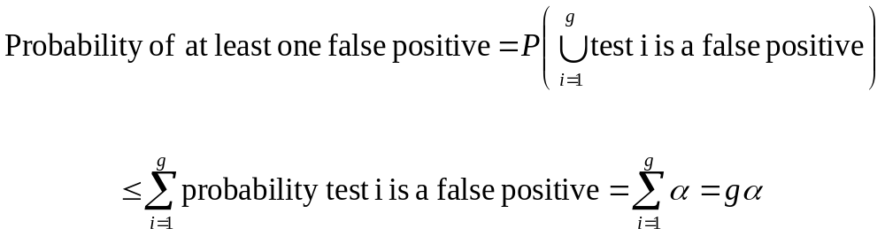
Multiple
Comparisons
Note, P(A U B) = P(A) + P(B) – P(A and B), so we can simply write
P(A U B) ≤ P(A) + P(B)
Consider A and B to be the event “false positive” for two distinct tests. The probability of A or B, either test being a false positive, is ≤ the sum of the individual tests being false positives.
Thus P(A U B) ≤ P(A) + P(B) = α + α =2α. In general for g tests, we write this as

Slide 17
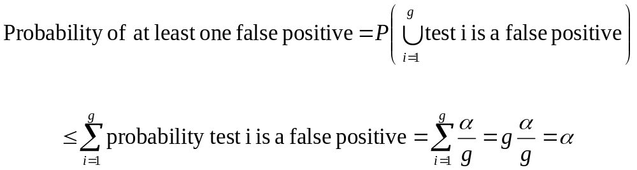
Multiple
Comparisons
Now if we use α/g as our significance level, we then have
Thus we use α*= α/g as our significance level and control the probability of at least one false positive for g tests to be at most α.

Slide 18
Multiple
Comparisons
Suppose we are interested in testing 4 β coefficients corresponding to 4 predictor variables. We then calculate 4 t statistics (which we will learn how to do soon).
Now suppose the p-values for the tests are p₁ = .027, p₂ = .007, p₃= .038, and p₄ = .003. Using the Bonferroni procedure to maintain a family wise error rate of .05, which tests are significant?
We compare the p-values to α/g = .05/4 = .0125.
Thus the tests corresponding to p₂ and p₄ are significant.

Slide 19
Multiple
Comparisons
An adaption to the Bonferroni procedure is the Bonferroni-Holm, which has more power. This is a stepwise procedure.
For g tests, the g p-values are sorted from smallest to largest. Recall our example where the p-values for the tests are p₁ = .027, p₂ = .007, p₃= .038, and p₄ = .003.
We then use p₍₁₎ = .003, p₍₂₎ = .007, p₍₃₎ = .027, and p₍₄₎ = .038. It is important to keep straight which p-value corresponds to which test. For example, p₍₁₎ corresponds to the fourth test.
We then compare the smallest p-value, p₍₁₎, to α/g. So here we would compare p₍₁₎ = .003 to α/g = .05/4 = .0125.

Slide 20
Multiple
Comparisons
Note that this first comparison is the same as with the regular Bonferroni procedure. That is only the case for the smallest p-value.
If p₍₁₎ < α/g we conclude that the corresponding test is significant and move on to the second smallest p-value.
If it is not significant, we stop and conclude no tests are significant. This will be the case for all steps.
If p₍₁₎ < α/g, we then compare p₍₂₎ to α/(g-1). So here we would compare p₍₂₎ = .007 to α/(g-1)= .05/3 = .0167.

Slide 21
Multiple
Comparisons
If p₍₂₎ < α/(g-1), we conclude that the corresponding test is significant and move on to the third smallest p-value.
If it is not significant, we stop and conclude only the first test is significant.
If p₍₂₎ < α/(g-1), we then compare p₍₃₎ to α/(g-2). So here we would compare p₍₃₎ = .027 to α/(g-2)= .05/2 = .025.
Here, p₍₃₎ = .027 > α/(g-2)= .025, so the procedure stops and we conclude that only the tests corresponding to the smallest two p-values are significant.

Slide 22
Multiple
Comparisons
Note that p₍₄₎ < α/(g-3), that is .038 < .05/1. but we do not consider it significant since we did not find p₍₃₎ significant.
In general this process goes until one of the p-values is not smaller than the adjusted alpha level or it continues till we compare the largest p-value to α/(g-(g-1)), which is just α.
Note this test has more power than the Bonferroni procedure. For the smallest p-value, the significance level is α/g in both cases.
But after that, the significance level in the Bonferroni- Holm procedure increases every step while for the Bonferroni procedure the significance level is always α/g.

